Slide 1

Basic Details of the Team and Problem Statement
Ministry/Organization Name/Student Innovation: Government Of Education
PS Code: 1362
Problem Statement Title: Student Dropout Analysis For School Education
Team Name: The Odd Squad
Team Leader Name: Chaudhari Jwalant
Institute Code (AISHE):U0136
Institute Name: Government Of Education
Theme Name: Smart Education

Slide 2
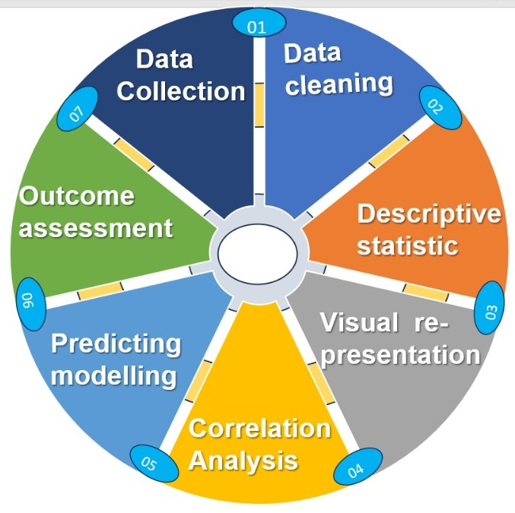
Idea/Approach Details
Idea/Solution
Use statistical analysis to identify patterns and trends in dropout rates over time, across different grades, and within specific demographic groups (e.g., Gender, Cast, Area , City)
Compare dropout rates and related factors across different schools, districts, or regions to understand variations and identify best practices or areas for improvement.
Train a machine learning model on the extracted features to predict whether a student is at risk of dropping out.
Technology Stack
Machine Learning: Random Forest
Data Pre-processing: Pandas, NumPy, Skit-learn
Web Development: Python
Analysis: Power BI , Excel ,PowerPoint

Slide 3
Idea/Approach Details
Use Cases
Show Stopper
Identify students at risk of dropping out
Understand the reasons for student dropout
Evaluate the effectiveness of dropout prevention programs
Improve school climate and culture
Improve Government policies according to analysis
Data privacy and security concerns: Schools need to ensure that student data is properly anonymized and that it is only used for authorized purposes.
Lack of Historical Data : Insufficient historical data to perform meaningful trend analysis and understand long-term patterns.
Model interpretability: Schools need to be able to understand why their model is making the predictions that it is making.
High Dimensionality and Complexity : Dealing with a large number of variables or complex data structures that make analysis and interpretation challenging

Slide 4
Team Member Details
Team Leader Name: Chaudhari Jwalant H
Branch: BSc Data Science Stream: IT Year: III
Team Member 1 Name: Soni Kax D
Branch: BSc AIML Stream: IT Year: III
Team Member 2 Name: Panchal Kuldeep G
Branch: BSc AIML Stream: IT Year: III
Team Member 3 Name: Vaghasiya Meet J
Branch: BSc AIML Stream: IT Year: III
Team Member 4 Name: Jadav Nishtha
Branch: BSc AIML Stream: IT Year: III
Team Member 5 Name: Makwana Nikita
Branch: BSc AIML Stream: IT Year: III
Team Mentor 1 Name: Type Your Name Here
Category (Academic/Industry): Expertise (AI/ML/Blockchain etc): Domain Experience (in years):
Team Mentor 2 Name: Type Your Name Here
Category (Academic/Industry): Expertise (AI/ML/Blockchain etc): Domain Experience (in years):

